Slide 1
Tableau Assignment_1
File created on: 1/26/2024 7:21:45 AM

Slide 2
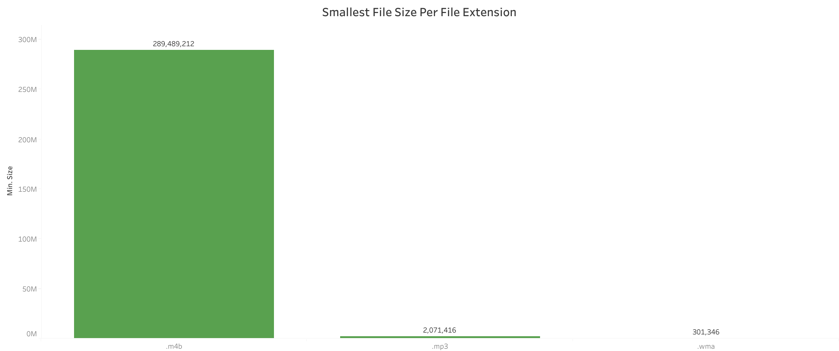

Slide 3
